Slide 1
Module 2
ECF Client Creation

Slide 2
Yahoo IM Client Creation
This tutorial will cover creating an ECF IM client for the Yahoo protocol (ymsg)
  We’ll use jymsg (http://jymsg9.sourceforge.net/)
The steps will apply to any other type of messaging protocol so we encourage users to create IM clients for their favorite protocol
Reference implementation available via CVS
  ecf1.osuosl.org/ecf/plugins/org.eclipse.ecf.provider.yahoo

Slide 3
Yahoo IM Client Creation
Step 1
  Create an identity
    Create a class, YahooID that extends org.eclipse.ecf.core.identity.BaseID

Slide 4
Yahoo IM Client Creation
Step 2
  Define and register a namespace
    Create a class, YahooNamespace that extends org.eclipse.ecf.core.identity.Namespace
    Register with the org.eclipse.ecf.namespace extension point

Slide 5
Yahoo IM Client Creation
Step 3a
  Create a container instantiator
    Create a class, YahooContainerInstantiator that implements org.eclipse.ecf.core.provider.IContainerInstantiator
    All we need to do here is create an ID via the IDFactory and return a new YahooContainer instance (stubbed)

Slide 6
Yahoo IM Client Creation
Step 3b
  Define a container factory
    Extend the org.eclipse.ecf.containerFactory extension point
  Create three properties
    org.eclipse.ecf.example.collab.ui.JoinGroupWizardPage.usepassword
      true
    org.eclipse.ecf.example.collab.ui.JoinGroupWizardPage.examplegroupid
      <user>
    org.eclipse.ecf.example.collab.ui.JoinGroupWizardPage.groupIDLabel
      “Account”

Slide 7
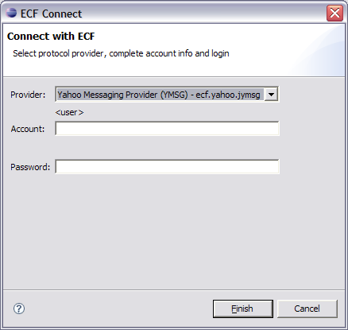
Yahoo IM Client Creation

Slide 8
Yahoo IM Client Creation
Step 4a
  Implement the IContainer interface
    Create a class, YahooContainer that implements org.eclipse.ecf.core.provider.IContainer
  This container will represent the connection to the Yahoo servers

Slide 9
Yahoo IM Client Creation
Step 4b
  Constructor
    Grab the localID
    Create a new yahoo Session instance
    Create a new YahooPresenceContainer

Slide 10
Yahoo IM Client Creation
Step 4c
  connect(…)
    Grab the user information from the targetID
    Login to the Yahoo messaging server
    Populate the initial roster (buddy list)
  Recommend looking at the reference implementation to complete the steps

Slide 11
Yahoo IM Client Creation
Step 5a
  Create a YahooPresenceContainer that implements IPresenceContainer

Slide 12
Yahoo IM Client Creation
Step 5b
  Create a new IMessageSender implementation
    See getMessageSender() in IPresenceContainer
  We will simply send a text message using the jymsg API
    See sendMessage(…) in Session

Slide 13
Yahoo IM Client Creation
Step 6
  Create a new IMessageSender implementation
    See getMessageSender() in IPresenceContainer
  We will simply send a text message using the jymsg API
    See sendMessage(…) in Session

Slide 14
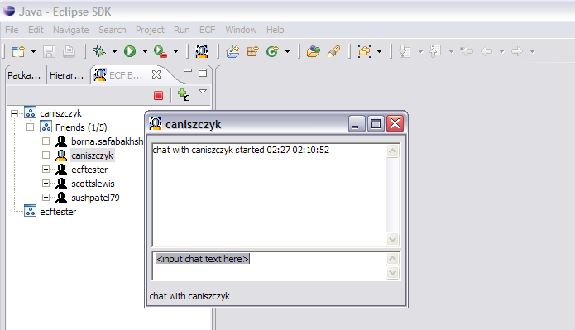
Yahoo IM Client Creation

Slide 15
ECF Whiteboard Application
This tutorial will cover creating an ECF Whiteboad application that uses the datashare APIs
Reference implementation available via CVS
  ecf1.osuosl.org/ecf/plugins/org.eclipse.ecf.provider.yahoo

Slide 16
ECF Whiteboard Application
Step 1

